Slide 1
Number Systems

Slide 2
Number Systems & Codes
Part I: Number Systems
Information Representations
Positional Notations
Decimal (base 10) Number System
Other Number Systems & _x000b_Base-R to Decimal Conversion
Decimal-to-Binary Conversion
  Sum-of-Weights Method
  Repeated Division-by-2 Method (for whole numbers)
  Repeated Multiplication-by-2 Method (for fractions)

Slide 3
Lecture 2: Number Systems & Codes
Conversion between Decimal and other Bases
Conversion between Bases
Binary-Octal/Hexadecimal Conversion
Binary Arithmetic Operations
Negative Numbers Representation
  Sign-and-magnitude
  1s Complement
  2s Complement
Comparison of Sign-and-Magnitude and Complements

Slide 4
Lecture 2: Number Systems & Codes
Complements
  Diminished-Radix Complements
  Radix Complements
2s Complement Addition and Subtraction
1s Complement Addition and Subtraction
Overflow
Fixed-Point Numbers
Floating-Point Numbers
Excess Representation
Arithmetics with Floating-Point Numbers

Slide 5
Information Representation (1/4)
Numbers are important to computers
  represent information precisely
  can be processed
For example:
  to represent yes or no: use 0 for no and 1 for yes
  to represent 4 seasons: 0 (autumn), 1 (winter), 2(spring) and 3 (summer)
  matriculation number (8 alphanumeric) to represent individual students

Slide 6
Information Representation (2/4)
Elementary storage units inside computer are electronic switches. Each switch holds one of two states: on (1) or off (0).
We use a bit (binary digit), 0 or 1, to represent the state.
ON
OFF

Slide 7
Information Representation (3/4)
Storage units can be grouped together to cater for larger range of numbers. Example: 2 switches to represent 4 values.
0 (00)
1 (01)
2 (10)
3 (11)

Slide 8
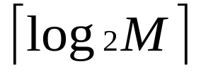
Information Representation (4/4)
In general, N bits can represent 2^{N} different values.
For M values, bits are needed.
1 bit → represents up to 2 values (0 or 1)
2 bits → rep. up to 4 values (00, 01, 10 or 11)
3 bits → rep. up to 8 values (000, 001, 010. …, 110, 111)
4 bits → rep. up to 16 values (0000, 0001, 0010, …, 1111)
32 values → requires 5 bits
64 values → requires 6 bits
1024 values → requires 10 bits
40 values → requires 6 bits
100 values → requires 7 bits

Slide 9
Positional Notations (1/3)
Position-independent notation
  each symbol denotes a value independent of its position: Egyptian number system
Relative-position notation
  Roman numerals symbols with different values: I (1), V (5), X (10), C (50), M (100)
  Examples: I, II, III, IV, VI, VI, VII, VIII, IX
  Relative position important: IV = 4 but VI = 6
Computations are difficult with the above two notations

Slide 10
Positional Notations (2/3)
Weighted-positional notation
  Decimal number system, symbols = { 0, 1, 2, 3, …, 9 }
  Position is important
  Example:(7594)₁₀ = (7x10³) + (5x10²) + (9x10¹) + (4x10⁰)
  The value of each symbol is dependent on its type and its position in the number
  In general,
  (a_{n}a_{n-1}… a₀)₁₀ = (a_{n} x 10^{n}) + (a_{n-1} x 10^{n-1}) + … + (a₀ x 10⁰)

Slide 11

Positional Notations (3/3)
Fractions are written in decimal numbers after the decimal point.
  2 = (2.75)₁₀ = (2 x 10⁰) + (7 x 10⁻¹) + (5 x 10⁻²)
  In general,
  (a_{n}a_{n-1}… a₀ . f₁f₂ … f_{m})₁₀ =
  (a_{n} x 10^{n}) + (a_{n-1}x10^{n-1}) + … + (a₀ x 10⁰) +
  (f₁ x 10⁻¹) + (f₂ x 10⁻²) + … + (f_{m} x 10^{-m})
The radix (or base) of the number system is the total number of digits allowed in the system.

Slide 12
Decimal (base 10) Number System
Weighting factors (or weights) are in powers-of-10:
… 10³ 10² 10¹ 10⁰.10⁻¹ 10⁻² 10⁻³ 10⁻⁴ …
To evaluate the decimal number 593.68, the digit in each position is multiplied by the corresponding weight:
5×10² + 9×10¹ + 3×10⁰ + 6×10⁻¹ + 8×10⁻² = (593.68)₁₀

Slide 13
Other Number Systems &
Base-R to Decimal Conversion (1/3)
Binary (base 2): weights in powers-of-2.
  Binary digits (bits): 0,1.
Octal (base 8): weights in powers-of-8.
  Octal digits: 0,1,2,3,4,5,6,7.
Hexadecimal (base 16): weights in powers-of-16.
  Hexadecimal digits: 0,1,2,3,4,5,6,7,8,9,A,B,C,D,E,F.
Base R: weights in powers-of-R.

Slide 14
Other Number Systems &
Base-R to Decimal Conversion (2/3)
(1101.101)₂ = 1×2³ + 1×2² + 1×2⁰ + 1×2⁻¹ + 1×2⁻³ = 8 + 4 + 1 + 0.5 + 0.125 = (13.625)₁₀
(572.6)₈ = 5×8² + 7×8¹ + 2×8⁰ + 6×8⁻¹ = 320 + 56 + 2 + 0.75 = (378.75)₁₀
(2A.8)₁₆ = 2×16¹ + 10×16⁰ + 8×16⁻¹ = 32 + 10 + 0.5 = (42.5)₁₀
(341.24)₅ = 3×5² + 4×5¹ + 1×5⁰ + 2×5⁻¹ + 4×5⁻² = 75 + 20 + 1 + 0.4 + 0.16 = (96.56)₁₀

Slide 15
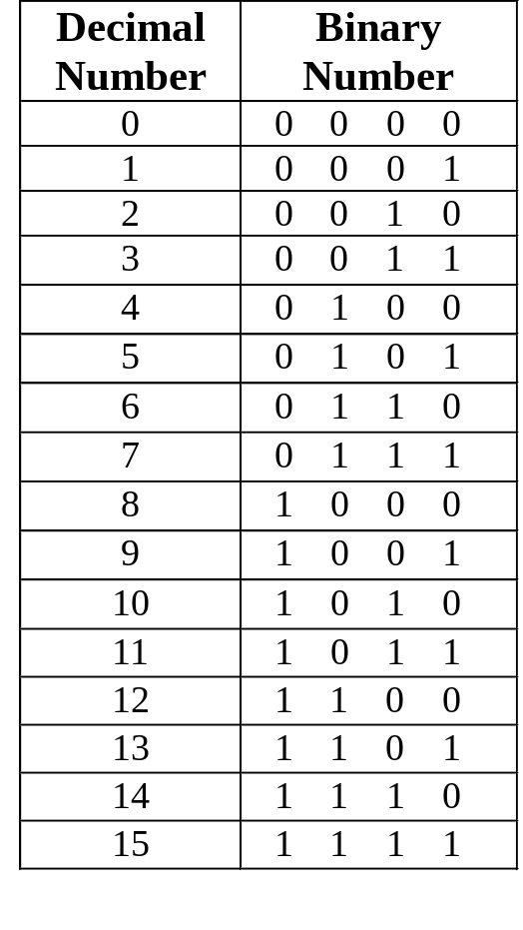
Other Number Systems &
Base-R to Decimal Conversion (3/3)
Counting in Binary
Assuming non-negative values, n bits → largest value 2^{n} – 1.
Examples: 4 bits → 0 to 15;
6 bits → 0 to 63.
range of m values → log₂m bits

Slide 16
Decimal-to-Binary Conversion
Method 1: Sum-of-Weights Method
Method 2:
  Repeated Division-by-2 Method (for whole numbers)
  Repeated Multiplication-by-2 Method (for fractions)

Slide 17
Sum-of-Weights Method
Determine the set of binary weights whose sum is equal to the decimal number.
(9)₁₀ = 8 + 1 = 2³ + 2⁰ = (1001)₂
(18)₁₀ = 16 + 2 = 2⁴ + 2¹ = (10010)₂
(58)₁₀ = 32 + 16 + 8 + 2 = 2⁵ + 2⁴ + 2³ + 2¹ = (111010)₂
(0.625)₁₀ = 0.5 + 0.125 = 2⁻¹ + 2⁻³ = (0.101)₂

Slide 18
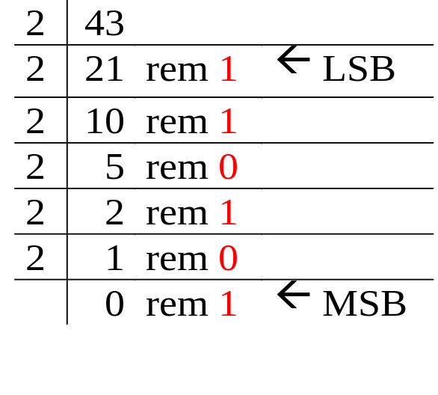
Repeated Division-by-2 Method
To convert a whole number to binary, use successive division by 2 until the quotient is 0. The remainders form the answer, with the first remainder as the least significant bit (LSB) and the last as the most significant bit (MSB).
(43)₁₀ = (101011)₂

Slide 19
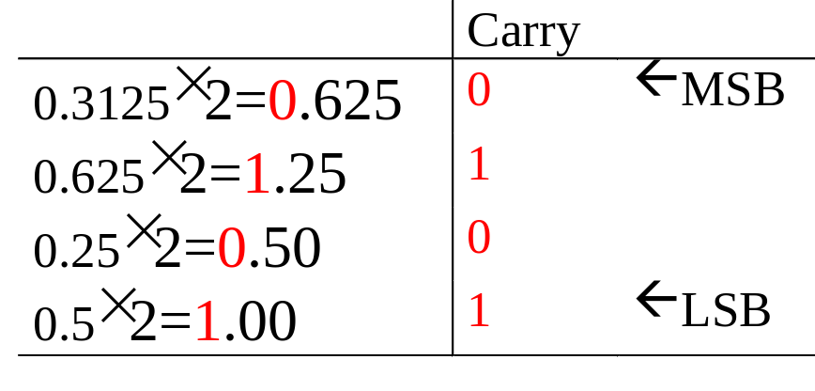
Repeated Multiplication-by-2 Method
To convert decimal fractions to binary, repeated multiplication by 2 is used, until the fractional product is 0 (or until the desired number of decimal places). The carried digits, or carries, produce the answer, with the first carry as the MSB, and the last as the LSB.
(0.3125)₁₀ = (.0101)₂

Slide 20
Conversion between Decimal and other Bases
Base-R to decimal: multiply digits with their corresponding weights.
Decimal to binary (base 2)
  whole numbers: repeated division-by-2
  fractions: repeated multiplication-by-2
Decimal to base-R
  whole numbers: repeated division-by-R
  fractions: repeated multiplication-by-R

Slide 21
Conversion between Bases
In general, conversion between bases can be done via decimal:
Shortcuts for conversion between bases 2, 8, 16.
Base-2 Base-2
Base-3 Base-3
Base-4 Decimal Base-4
… ….
Base-R Base-R

Slide 22
Binary-Octal/Hexadecimal Conversion
Binary → Octal: Partition in groups of 3
  (10 111 011 001 . 101 110)₂ = (2731.56)₈
Octal → Binary: reverse
  (2731.56)₈ = (10 111 011 001 . 101 110)₂
Binary → Hexadecimal: Partition in groups of 4
  (101 1101 1001 . 1011 1000)₂ = (5D9.B8)₁₆
Hexadecimal → Binary: reverse
  (5D9.B8)₁₆ = (101 1101 1001 . 1011 1000)₂

Slide 23
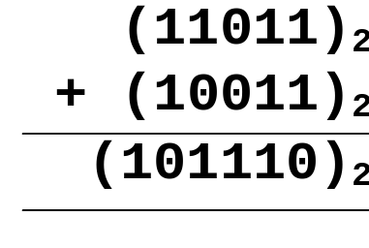
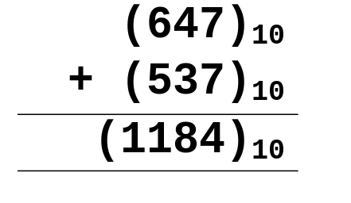
Binary Arithmetic Operations (1/6)
ADDITION
Like decimal numbers, two numbers can be added by adding each pair of digits together with carry propagation.

Slide 24
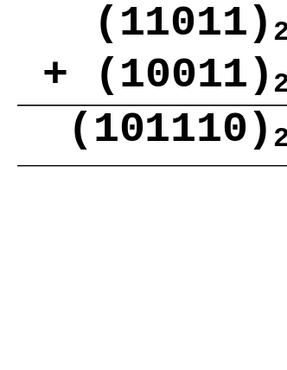
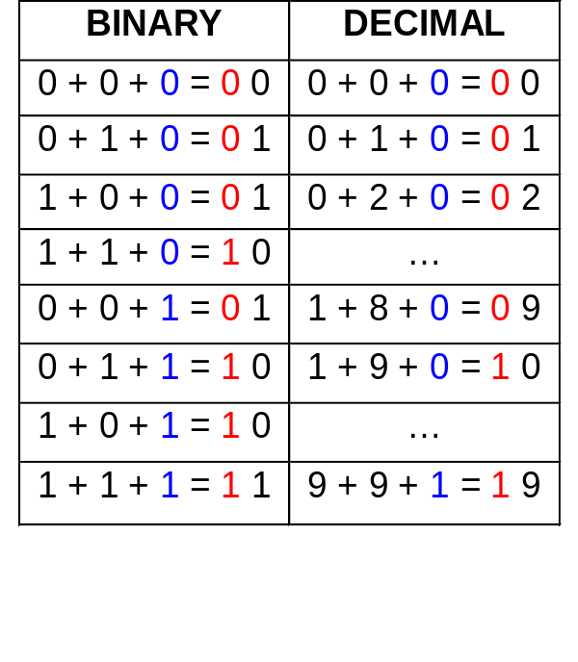
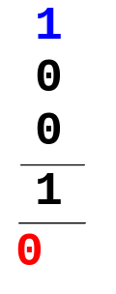
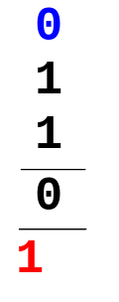
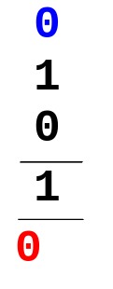
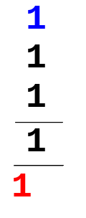
Binary Arithmetic Operations (2/6)
Digit addition table:
Carry in
Carry out

Slide 25
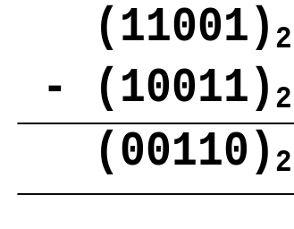
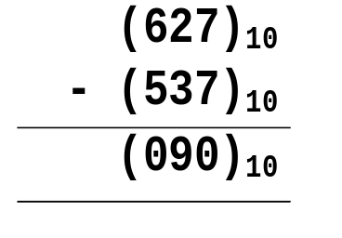
Binary Arithmetic Operations (3/6)
SUBTRACTION
Two numbers can be subtracted by subtracting each pair of digits together with borrowing, where needed.

Slide 26
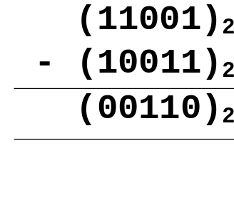
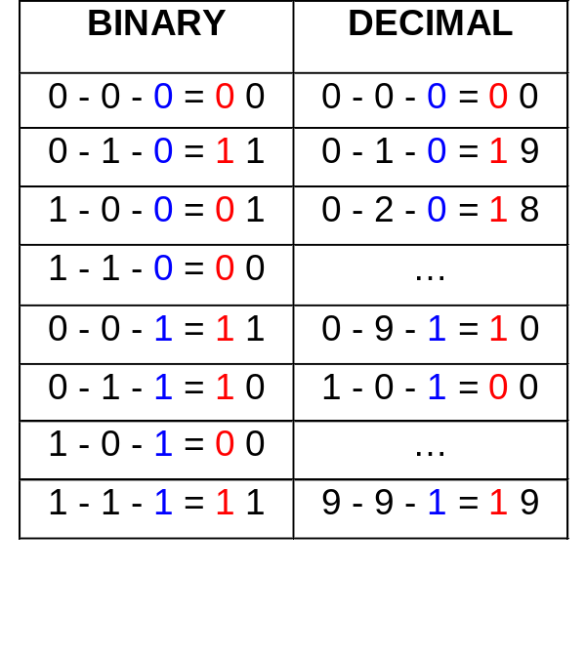
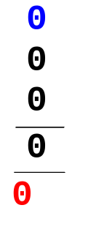
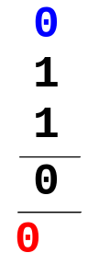
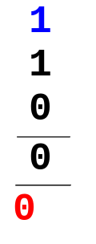
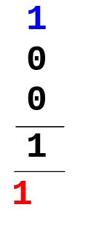
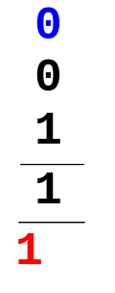
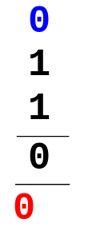
Binary Arithmetic Operations (4/6)
Digit subtraction table:
Borrow

Slide 27
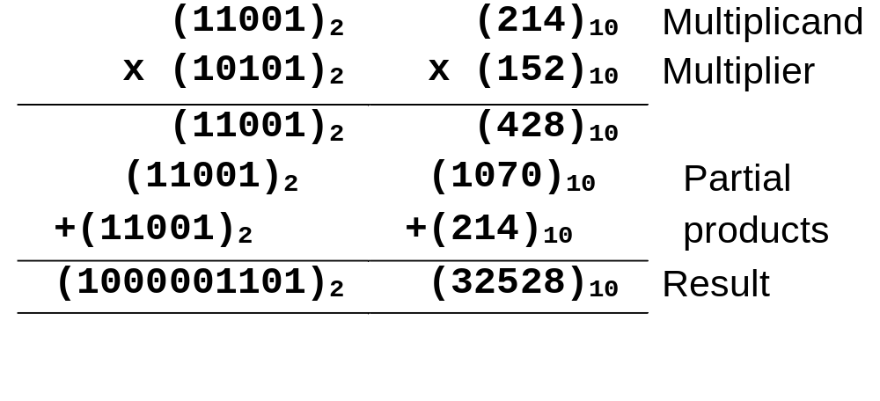
Binary Arithmetic Operations (5/6)
MULTIPLICATION
To multiply two numbers, take each digit of the multiplier and multiply it with the multiplicand. This produces a number of partial products which are then added.

Slide 28
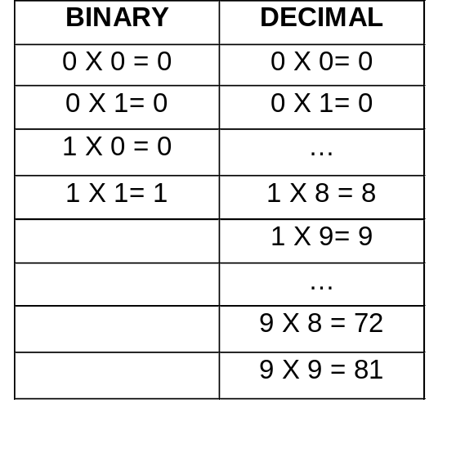
Binary Arithmetic Operations (6/6)
Digit multiplication table:

Slide 29
Negative Numbers Representation
Unsigned numbers: only non-negative values.
Signed numbers: include all values (positive and negative).
Till now, we have only considered how unsigned (non-negative) numbers can be represented. There are three common ways of representing signed numbers (positive and negative numbers) for binary numbers:
  Sign-and-Magnitude
  1s Complement
  2s Complement

Slide 30
Negative Numbers:
Sign-and-Magnitude (1/4)
Negative numbers are usually written by writing a minus sign in front.
  Example:
  - (12)₁₀ , - (1100)₂
In sign-and-magnitude representation, this sign is usually represented by a bit:
  0 for +
  1 for -

Slide 31
Negative Numbers:
Sign-and-Magnitude (2/4)
Example: an 8-bit number can have 1-bit sign and 7-bit magnitude.
sign
magnitude

Slide 32
Negative Numbers:
Sign-and-Magnitude (3/4)
Largest Positive Number: 0 1111111 +(127)₁₀
Largest Negative Number: 1 1111111 -(127)₁₀
Zeroes: 0 0000000 +(0)₁₀
1 0000000 -(0)₁₀
Range: -(127)₁₀ to +(127)₁₀
Question: For an n-bit sign-and-magnitude representation, what is the range of values that can be represented?

Slide 33
Negative Numbers:
Sign-and-Magnitude (4/4)
To negate a number, just invert the sign bit.
Examples:
- (0 0100001)_{sm} = (1 0100001)_{sm}
- (1 0000101)_{sm} = (0 0000101)_{sm}

Slide 34
1s and 2s Complement
Two other ways of representing signed numbers for binary numbers are:
  1s-complement
  2s-complement
They are preferred over the simple sign-and-magnitude representation.

Slide 35
1s Complement (1/3)
Given a number x which can be expressed as an n-bit binary number, its negative value can be obtained in 1s-complement representation using:
- x = 2^{n} - x - 1
Example: With an 8-bit number 00001100, its negative value, expressed in 1s complement, is obtained as follows:
-(00001100)₂ = - (12)₁₀
= (2⁸ - 12 - 1)₁₀
= (243)₁₀
= (11110011)_{1s}

Slide 36
1s Complement (2/3)
Essential technique: invert all the bits.
Examples: 1s complement of (00000001)_{1s} = (11111110)_{1s}
1s complement of (01111111)_{1s} = (10000000)_{1s}
Largest Positive Number: 0 1111111 +(127)₁₀
Largest Negative Number: 1 0000000 -(127)₁₀
Zeroes: 0 0000000
1 1111111
Range: -(127)₁₀ to +(127)₁₀
The most significant bit still represents the sign:
0 = +ve; 1 = -ve.

Slide 37
1s Complement (3/3)
Examples (assuming 8-bit binary numbers):
(14)₁₀ = (00001110)₂ = (00001110)_{1s}
-(14)₁₀ = -(00001110)₂ = (11110001)_{1s}
-(80)₁₀ = -( ? )₂ = ( ? )_{1s}

Slide 38
2s Complement (1/4)
Given a number x which can be expressed as an n-bit binary number, its negative number can be obtained in 2s-complement representation using:
- x = 2^{n} - x
Example: With an 8-bit number 00001100, its negative value in 2s complement is thus:
-(00001100)₂ = - (12)₁₀
= (2⁸ - 12)₁₀
= (244)₁₀
= (11110100)_{2s}

Slide 39
2s Complement (2/4)
Essential technique: invert all the bits and add 1.
Examples:
2s complement of
(00000001)_{2s} = (11111110)_{1s} (invert)
= (11111111)_{2s} (add 1)
2s complement of
(01111110)_{2s} = (10000001)_{1s} (invert)
= (10000010)_{2s} (add 1)

Slide 40
2s Complement (3/4)
Largest Positive Number: 0 1111111 +(127)₁₀
Largest Negative Number: 1 0000000 -(128)₁₀
Zero: 0 0000000
Range: -(128)₁₀ to +(127)₁₀
The most significant bit still represents the sign:
0 = +ve; 1 = -ve.

Slide 41
2s Complement (4/4)
Examples (assuming 8-bit binary numbers):
(14)₁₀ = (00001110)₂ = (00001110)_{2s}
-(14)₁₀ = -(00001110)₂ = (11110010)_{2s}
-(80)₁₀ = -( ? )₂ = ( ? )_{2s}

Slide 42
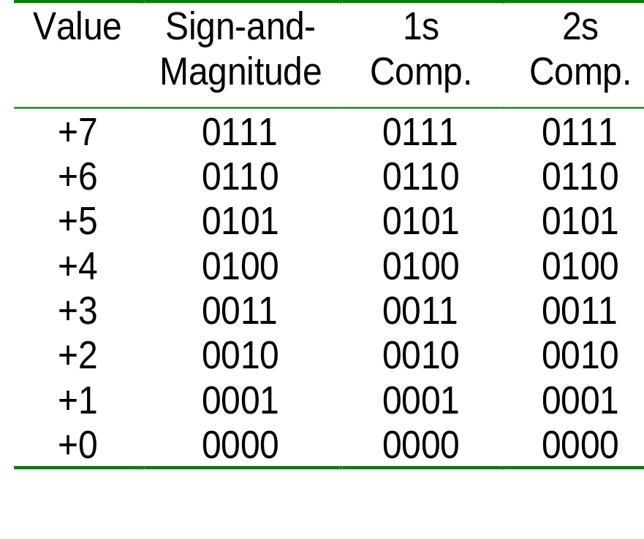
Comparisons of Sign-and-Magnitude and Complements (1/2)
Example: 4-bit signed number (positive values)
Important slide!
Mark this!

Slide 43
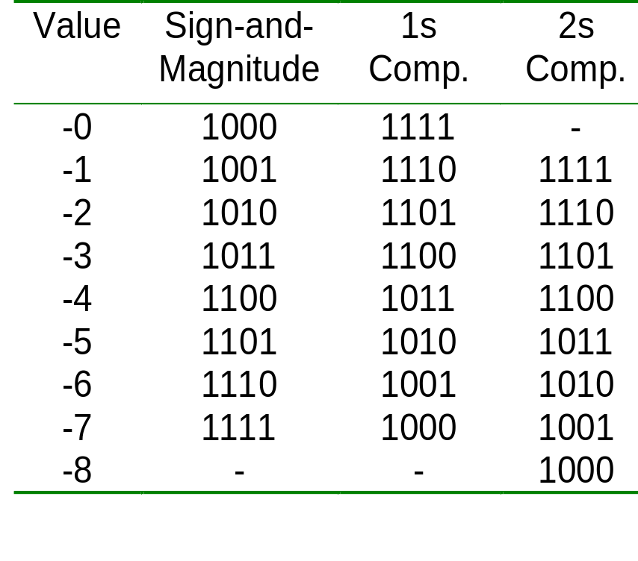
Comparisons of Sign-and-Magnitude and Complements (2/2)
Example: 4-bit signed number (negative values)
Important slide!
Mark this!

Slide 44
2s Complement Addition/Subtraction (1/3)
Algorithm for addition, A + B:
Perform binary addition on the two numbers.
Ignore the carry out of the MSB (most significant bit).
Check for overflow: Overflow occurs if the ‘carry in’ and ‘carry out’ of the MSB are different, or if result is opposite sign of A and B.
Algorithm for subtraction, A – B:
A – B = A + (–B)
Take 2s complement of B by inverting all the bits and adding 1.
Add the 2s complement of B to A.

Slide 45
2s Complement Addition/Subtraction (2/3)
Examples: 4-bit binary system
Which of the above is/are overflow(s)?
+3 0011
+ +4 + 0100
---- -------
+7 0111
---- -------
-2 1110
+ -6 + 1010
---- -------
-8 11000
---- -------
+6 0110
+ -3 + 1101
---- -------
+3 10011
---- -------
+4 0100
+ -7 + 1001
---- -------
-3 1101
---- -------

Slide 46
2s Complement Addition/Subtraction (3/3)
More examples: 4-bit binary system
Which of the above is/are overflow(s)?
-3 1101
+ -6 + 1010
---- -------
-9 10111
---- -------
+5 0101
+ +6 + 0110
---- -------
+11 1011
---- -------

Slide 47
1s Complement Addition/Subtraction (1/2)
Algorithm for addition, A + B:
Perform binary addition on the two numbers.
If there is a carry out of the MSB, add 1 to the result.
Check for overflow: Overflow occurs if result is opposite sign of A and B.
Algorithm for subtraction, A – B:
A – B = A + (–B)
Take 1s complement of B by inverting all the bits.
Add the 1s complement of B to A.

Slide 48
1s Complement Addition/Subtraction (2/2)
Examples: 4-bit binary system
+3 0011
+ +4 + 0100
---- -------
+7 0111
---- -------
+5 0101
+ -5 + 1010
---- -------
-0 1111
---- -------
-2 1101
+ -5 + 1010
---- ------
-7 10111
---- + 1
------
1000
-3 1100
+ -7 + 1000
---- -------
-10 10100
---- + 1
-------
0101

Slide 49
Overflow (1/2)
Signed binary numbers are of a fixed range.
If the result of addition/subtraction goes beyond this range, overflow occurs.
Two conditions under which overflow can occur are:
(i) positive add positive gives negative
(ii) negative add negative gives positive

Slide 50
Overflow (2/2)
Examples: 4-bit numbers (in 2s complement)
Range : (1000)_{2s} to (0111)_{2s} or (-8₁₀ to 7₁₀)
(i) (0101)_{2s} + (0110)_{2s}= (1011)_{2s}
(5)₁₀ + (6)₁₀= -(5)₁₀ ?! (overflow!)
(ii) (1001)_{2s} + (1101)_{2s} = (10110)_{2s} discard end-carry
= (0110)_{2s}
(-7)₁₀ + (-3)₁₀ = (6)₁₀ ?! (overflow!)

Slide 51
Fixed Point Numbers (1/2)
The signed and unsigned numbers representation given are fixed point numbers.
The binary point is assumed to be at a fixed location, say, at the end of the number:
Can represent all integers between –128 to 127 (for 8 bits).
binary point

Slide 52
Fixed Point Numbers (2/2)
In general, other locations for binary points possible.
Examples: If two fractional bits are used, we can represent:
  (001010.11)_{2s} = (10.75)₁₀
  (111110.11)_{2s} = -(000001.01)₂
  = -(1.25)₁₀
integer part
binary point
fraction part

Slide 53
Floating Point Numbers (1/5)
Fixed point numbers have limited range.
To represent very large or very small numbers, we use floating point numbers (cf. scientific numbers). Examples:
0.23 x 10²³ (very large positive number)
0.5 x 10⁻³² (very small positive number)
-0.1239 x 10⁻¹⁸ (very small negative number)

Slide 54
Floating Point Numbers (2/5)
Floating point numbers have three parts:
sign, mantissa, and exponent
The base (radix) is assumed (usually base 2).
The sign is a single bit (0 for positive number, 1 for negative).
sign
mantissa
exponent

Slide 55
Floating Point Numbers (3/5)
Mantissa is usually in normalised form:
(base 10) 23 x 10²¹ normalised to 0.23 x 10²³
(base 10) -0.0017 x 10²¹ normalised to -0.17 x 10¹⁹
(base 2) 0.01101 x 2³ normalised to 0.1101 x 2²
Normalised form: The fraction portion cannot begin with zero.
More bits in exponent gives larger range.
More bits for mantissa gives better precision.

Slide 56
Floating Point Numbers (4/5)
Exponent is usually expressed in complement or excess form (excess form to be discussed later).
Example: Express -(6.5)₁₀ in base-2 normalised form
-(6.5)₁₀ = -(110.1)₂ = -0.1101 x 2³
Assuming that the floating-point representation contains 1-bit sign, 5-bit normalised mantissa, and 4-bit exponent.
The above example will be represented as
1
11010
0011

Slide 57
Floating Point Numbers (5/5)
Example: Express (0.1875)₁₀ in base-2 normalised form
(0.1875)₁₀ = (0.0011)₂ = 0.11 x 2⁻²
Assuming that the floating-pt rep. contains 1-bit sign, 5-bit normalised mantissa, and 4-bit exponent.
The above example will be represented as
0
11000
1101
If exponent is in 1’s complement.
0
11000
1110
If exponent is in 2’s complement.
0
11000
0110
If exponent is in excess-8.

Slide 58
Excess Representation (1/2)
The excess representation allows the range of values to be distributed evenly among the positive and negative value, by a simple translation (addition/subtraction).
Example: For a 3-bit representation, we may use excess-4.
Excess-4 Representation | Value
000 | -4
001 | -3
010 | -2
011 | -1
100 | 0
101 | 1
110 | 2
111 | 3

Slide 59
Excess Representation (2/2)
Example: For a 4-bit representation, we may use excess-8.
Excess-8 Representation | Value
0000 | -8
0001 | -7
0010 | -6
0011 | -5
0100 | -4
0101 | -3
0110 | -2
0111 | -1
Excess-8 Representation | Value
1000 | 0
1001 | 1
1010 | 2
1011 | 3
1100 | 4
1101 | 5
1110 | 6
1111 | 7

Slide 60
Arithmetics with Floating Point Numbers (1/2)
Arithmetic is more difficult for floating point numbers.
MULTIPLICATION
Steps: (i) multiply the mantissa
(ii) add-up the exponents
(iii) normalise
Example:
(0.12 x 10²)₁₀ x (0.2 x 10³⁰)₁₀
= (0.12 x 0.2)₁₀ x 10²⁺³⁰
= (0.024)₁₀ x 10³² (normalise)
= (0.24 x 10³¹)₁₀

Slide 61
Arithmetics with Floating Point Numbers (2/2)
ADDITION
Steps: (i) equalise the exponents
(ii) add-up the mantissa
(iii) normalise
Example:
(0.12 x 10³)₁₀ + (0.2 x 10²)₁₀
= (0.12 x 10³)₁₀ + (0.02 x 10³)₁₀ (equalise exponents)
= (0.12 + 0.02)₁₀ x 10³ (add mantissa)
= (0.14 x 10³)₁₀
Can you figure out how to do perform SUBTRACTION and DIVISION for (binary/decimal) floating-point numbers?

Slide 62
Number Systems & Codes
Part II: Codes
Binary Coded Decimal (BCD)
Gray Code
  Binary-to-Gray Conversion
  Gray-to-Binary Conversion
Other Decimal Codes
Self-Complementing Codes
Alphanumeric Codes
Error Detection Codes

Slide 63
Binary Coded Decimal (BCD) (1/3)
Decimal numbers are more natural to humans. Binary numbers are natural to computers. Quite expensive to convert between the two.
If little calculation is involved, we can use some coding schemes for decimal numbers.
Represent each decimal digit as a 4-bit binary code.

Slide 64
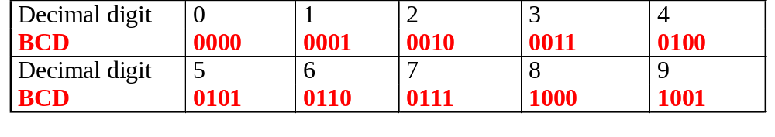
Binary Coded Decimal (BCD) (2/3)
Some codes are unused, eg: (1010)_{BCD}, (1011) _{BCD}, …, (1111) _{BCD}. These codes are considered as errors.
Easy to convert, but arithmetic operations are more complicated.
Suitable for interfaces such as keypad inputs and digital readouts.

Slide 65
Binary Coded Decimal (BCD) (3/3)
Examples:
(234)₁₀ = (0010 0011 0100)_{BCD}
(7093)₁₀ = (0111 0000 1001 0011)_{BCD}
(1000 0110)_{BCD} = (86)₁₀
(1001 0100 0111 0010)_{BCD} = (9472)₁₀
Notes: BCD is not equivalent to binary.
Example: (234)₁₀ = (11101010)₂

Slide 66
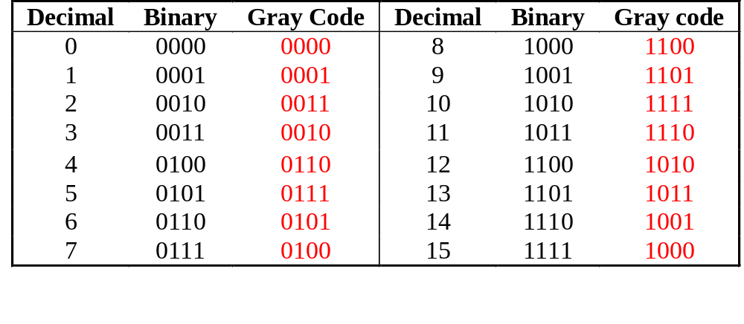
The Gray Code (1/3)
Unweighted (not an arithmetic code).
Only a single bit change from one code number to the next.
Good for error detection.
Q. How to generate 5-bit standard Gray code?
Q. How to generate n-bit standard Gray code?

Slide 67
The Gray Code (2/3)
0000
0001
0100
0101
0111
0110
0010
0011
0001
0000
1100
1101
1111
1110
1010
1011
1001
1000
0011
0010
0001
0000
0110
0111
0101
0100
0010
0011
0001
0000
Generating 4-bit standard Gray code.

Slide 68
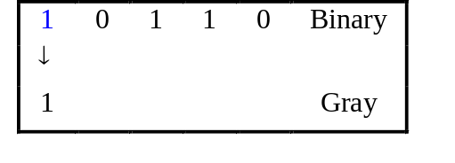
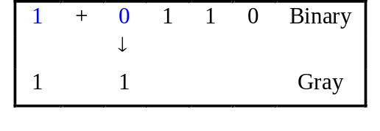
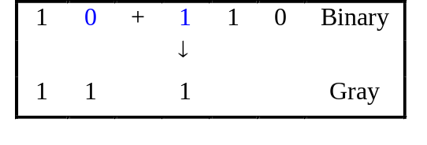
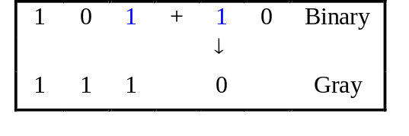
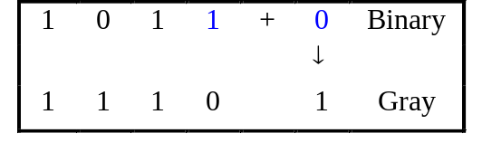
Binary-to-Gray Code Conversion
Retain most significant bit.
From left to right, add each adjacent pair of binary code bits to get the next Gray code bit, discarding carries.
Example: Convert binary number 10110 to Gray code.
(10110)₂ = (11101)_{Gray}

Slide 69
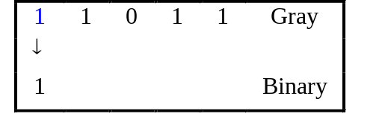
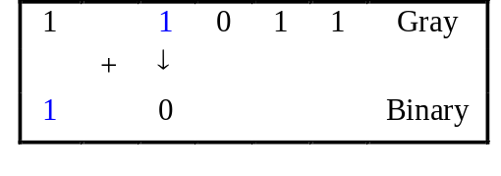
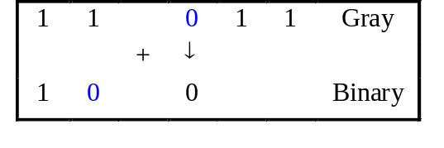
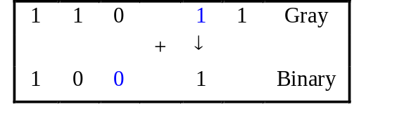
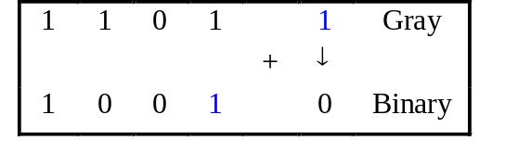
Gray-to-Binary Conversion
Retain most significant bit.
From left to right, add each binary code bit generated to the Gray code bit in the next position, discarding carries.
Example: Convert Gray code 11011 to binary.
(11011)_{Gray} = (10010)₂

Slide 70
Alphanumeric Codes (1/3)
Apart from numbers, computers also handle textual data.
Character set frequently used includes:
  alphabets: ‘A’ .. ‘Z’, and ‘a’ .. ‘z’
  digits: ‘0’ .. ‘9’
  special symbols: ‘$’, ‘.’, ‘,’, ‘@’, ‘*’, …
  non-printable: SOH, NULL, BELL, …
Usually, these characters can be represented using 7 or 8 bits.

Slide 71
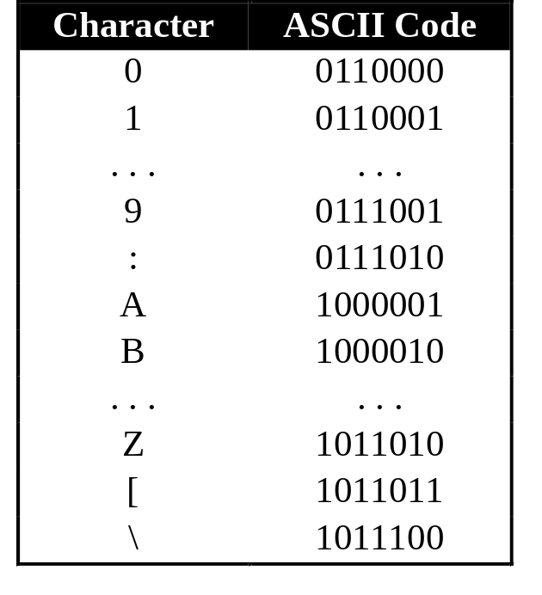
Alphanumeric Codes (2/3)
ASCII: 7-bit, plus a parity bit for error detection (odd/even parity).

Slide 72
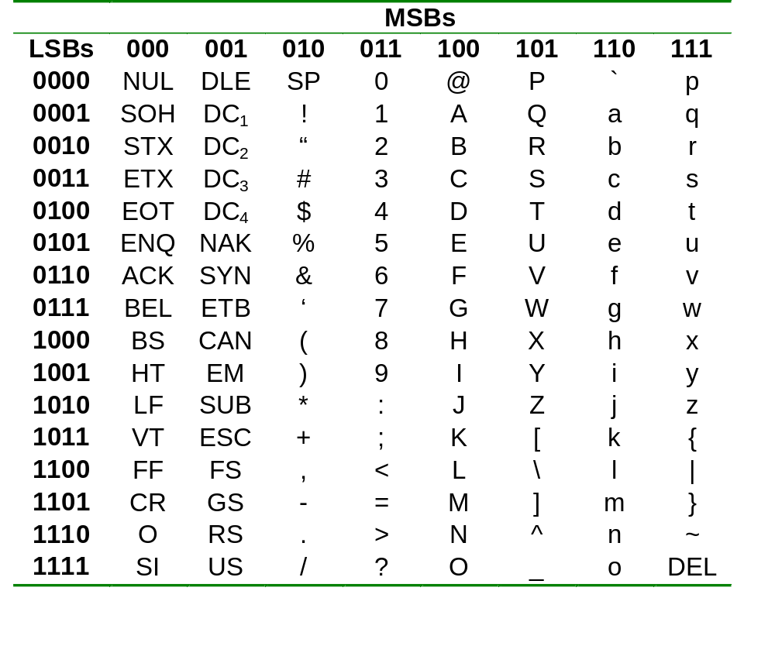
Alphanumeric Codes (3/3)
ASCII table:

Slide 73
Error Detection Codes (1/4)
Errors can occur data transmission. They should be detected, so that re-transmission can be requested.
With binary numbers, usually single-bit errors occur.
  Example: 0010 erroneously transmitted as 0011, or 0000, or 0110, or 1010.
Biquinary code uses 3 additional bits for error-detection. For single-error detection, one additional bit is needed.

Slide 74
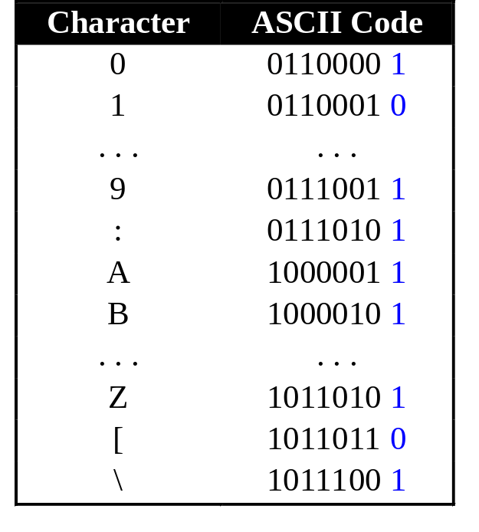
Error Detection Codes (2/4)
Parity bit.
  Even parity: additional bit supplied to make total number of ‘1’s even.
  Odd parity: additional bit supplied to make total number of ‘1’s odd.
Example: Odd parity.
Parity bits

Slide 75
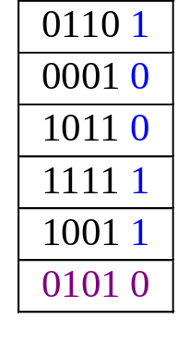
Error Detection Codes (3/4)
Parity bit can detect odd number of errors but not even number of errors.
  Example: For odd parity numbers,
  10011 → 10001 (detected)
  10011 → 10101 (non detected)
Parity bits can also be
applied to a block of data:
Column-wise parity
Row-wise parity

Slide 76
Error Detection Codes (4/4)
Sometimes, it is not enough to do error detection. We may want to do error correction.
Error correction is expensive. In practice, we may use only single-bit error correction.
Popular technique: Hamming Code (not covered).

Slide 77
Thank You

